Slide 1
Twitter App Overview
Key Features
App allows the user to type in the twitter screen name of any Twitter user and displays user's tweets
UI carefully mocked to Twitter Home page
Implementation details:
-User interface using JSON data from a RESTful request
No third-party libraries have been used
API used:
Application Only Authentication (https://dev.twitter.com/oauth/application-only)
The https://api.twitter.com/1.1/statuses/user_timeline.json?screen_name=<SCREEN_NAME> endpoint to get a list of tweets for a user
Coding components:
- Windows 10
- UWP Application
- C# 6.0
- MVVM architecture
- Unit Testing

Slide 2
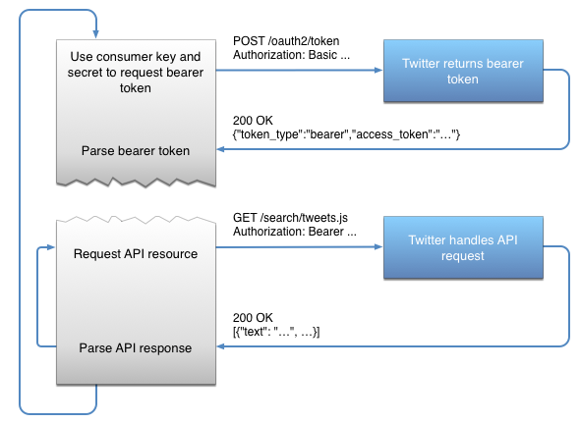
Twitter App APIs

Slide 3
Approach to this project
Discovery
Analysed API structure
Design & Development
Developed Console only App
Testing
App worked well in .NET Framework
Analysed JSON response
Designed UX/UI
Defined unit test cases
Unit tests written to test the functionality
Timeline

Slide 4
Twitter App Components
UI (Twitter Feeder App.UI)
Response
Request
Service (Twitter Feeder App.Services)
Twitter
Within this app there are 4 projects as follows:
Twitterfeedapp.library
Twitterfeedapp.services
Twitterfeedapp.ui
Twitterfeedapp.test

